Slide 1


print("Final Project")
Maria Amaral
Notes:
Welcome to my final project presentation. Today I will show you a machine learning prediction model that successfully recognizes epileptic seizures from electroencephalogram readings.

Slide 2
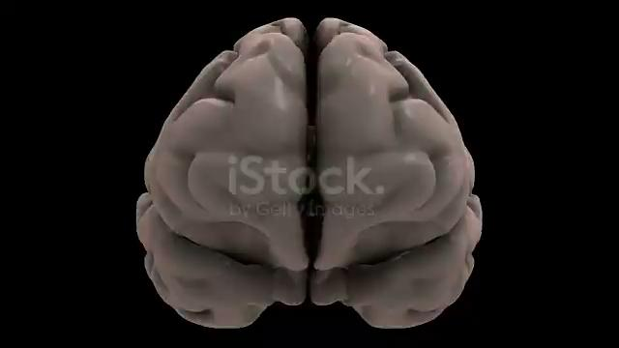
Predicting Epileptic Seizures
Seizures are a sudden burst of abnormal electrical activity. This disrupts the normal pattern of brain waves.
Normal Activity: Regular, consistent patterns.
Seizure Activity: Spikes, sharp waves, and unusual patterns.
Notes:
Quick overview on seizures: They are a sudden burst of abnormal electrical activity in the brain and can cause damage over time, in the EEG reading they look like big spiky waves

Slide 3

Predicting Epileptic Seizures
To measure them we use a non-invasive method that records electrical activity in the brain. This equipment is called EEG.
Directly measures brain activity.
Can locate the origin of the seizure in the brain.
Helps in differentiating seizure types.
Notes:
The EEG is an equipment that uses electrodes in very specific placements on the scalp which are capable of recording our brain waves by capturing snapshots of the electrical activity over time

Slide 4
Project Development Overview
Data Cleaning, Viz and EDA
Feature Engineering and Preprocessing
Model Selection and Evaluation
Improving the model
Comparison with other models
1
2
3
4
5
Notes:
So in order to successfully identify a seizure activity I followed the following steps:
Data Cleaning, Visualization and EDA
Where I explored and understood the data on Jupyter Notebook and Tableau.
Feature Engineering and Preprocessing
Define the classification problem, get target variable, then split into train and test, and finally scaled it
Model Selection and Evaluation
Handle imbalance, implemented Logistic Regression, Decision Tree, KNN, SVM, Random Forest, and Evaluated their performance
Improving the model
Hyperparameter Tuning using GridSearchCV for Random Forest, confusion matrix and cross val.
Comparison with other models
SMOTE vs. Undersampling, Binary vs. Multiclass Classification

Slide 5

The Data
11500 records representing 500 individuals.
Each record: 178 data points spanning 1 second of EEG activity.
Class Categories:
Seizure activity
Tumor presence
Healthy location
Eyes Closed
Eyes Open
Notes:
I used an excellent dataset I got from kaggle and was originally from UCI Machine learning repository with hundreds of thousands of records of electrical activity records. Those were separated into 5 categories: 1. Seizure activity, 2. Recorded in the location of a tumor, 3. Recorded in a healthy location, 4. With eyes closed and 5 with eyes open. It's important to make a distinction because of something called artifacts, such as blinking, that can appear like electrical activity but it's just noise. Now let's visualize the data

Slide 6


Slide 7
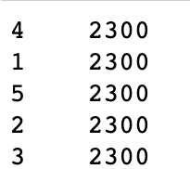
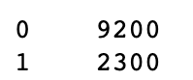
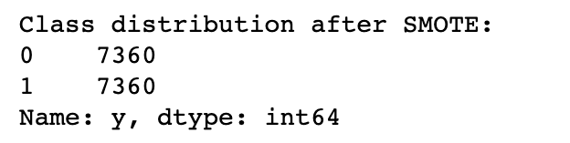
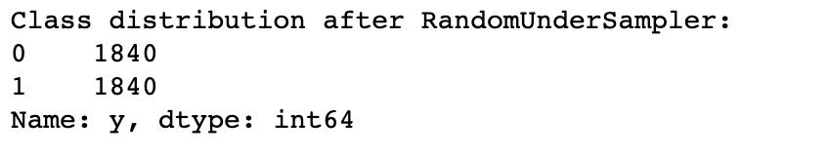
The Machine Learning Process
Target variable distribution before binary classification:
And after:
Oversampling -> better accuracy by creating artificial data
Undersampling -> still good accuracy but randomly selects smaller number of samples
Notes:
When building the models, I noticed that the target variables were balanced, which would simplify the process of a multiclass classification problem, but my main focus was a binary classification, seizure vs. no seizure. That created an imbalance, which could have been solved in different ways: Using SMOTE, oversampling, or RandomUndersampler, at the end, both of them performed well, but SMOTE was better.

Slide 8
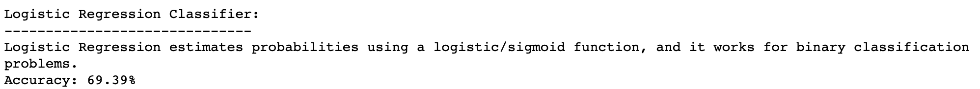
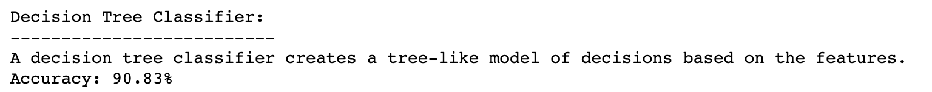
The Models
Notes:
Now let's see how accurate the models were. The first one of Logistic Regression is the simplest and performed the worst, but it gave me the indication that the data itself is easy enough for the machine to find the patterns, after trying some other ones, the random forest classifier ended up having the best performance. It's important to mention that a good result is often suspicious, so it was important to look out for any data leakage in the process of resampling and scaling, and to perform hyperparameter tuning and cross validation

Slide 9
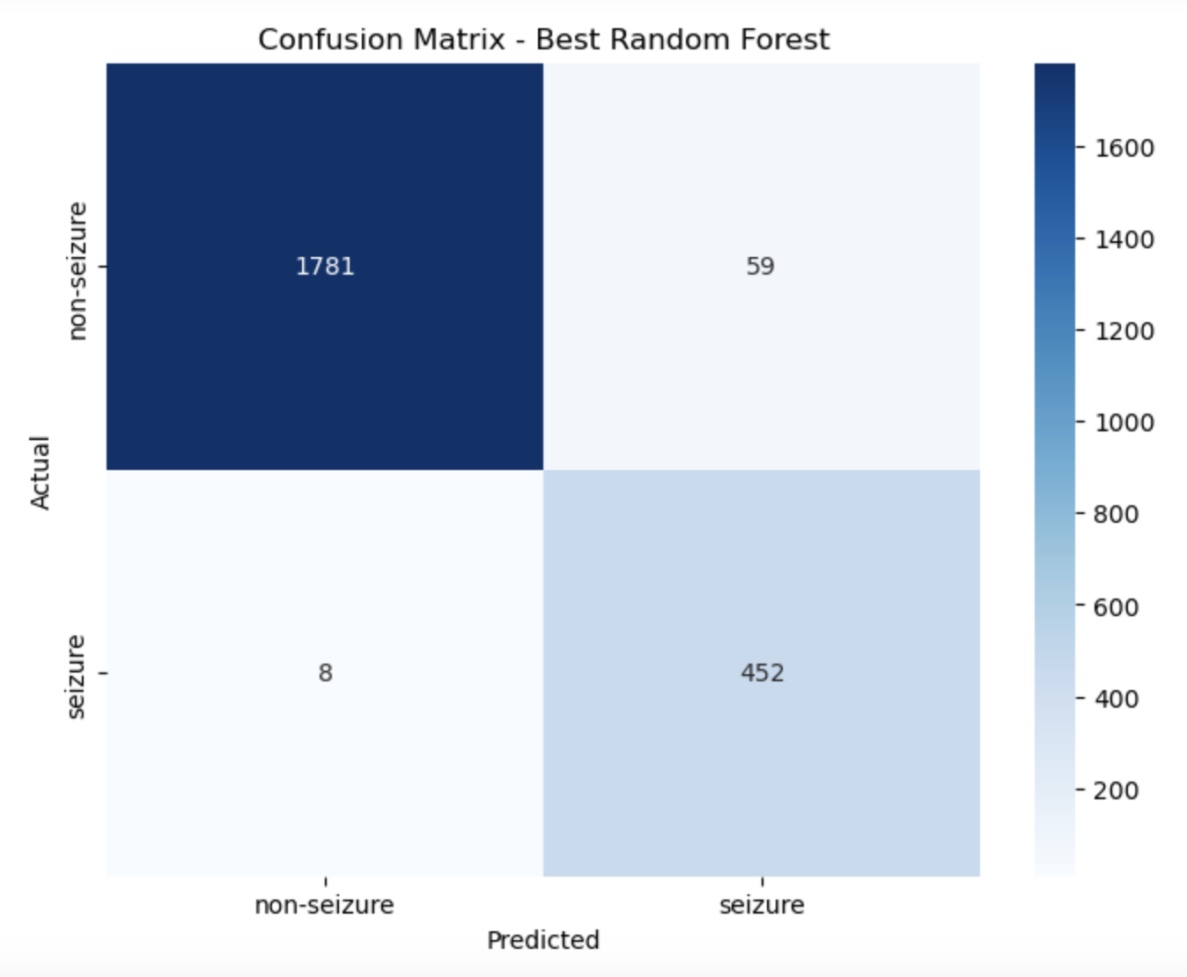
Small number of false negatives
Notes:
As this model is designed for healthcare purposes, getting a small number for false negatives was very important because predicting there is no seizure when in fact there is one can be harmful for the patient.

Slide 10
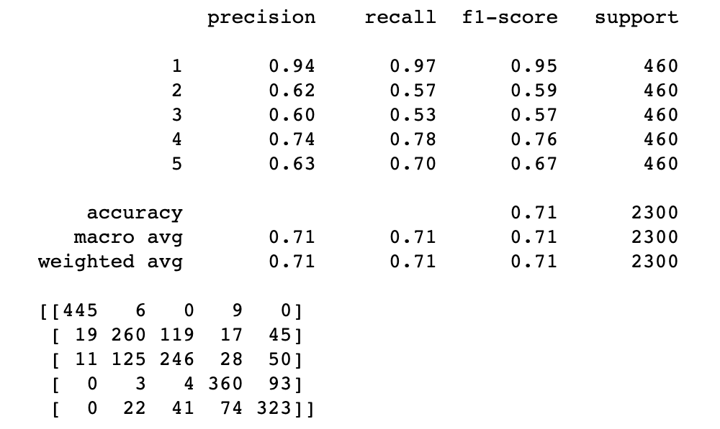
Multiclass Classification
Report
Conclusion
Class 1 is very well predicted, indicating it might have distinct features differentiating it from other classes.
There's evident confusion between classes 2, 3, and 5. Classes 4 and 5 also show a significant overlap.
Notes:
Conclusion:
Class 1 is very well predicted, indicating it might have distinct features differentiating it from other classes.
There's evident confusion between classes 2, 3, and 5. Classes 4 and 5 also show a significant overlap. Those are the eyes open and closed.

Slide 11

A model like this could be used from responsive neurostimulant implants to clinical research and trials
Technology can promote great advances in the medical community and I hope to be a part of that
In the meantime, thanks for watching!

Slide 12
The End

